Slide 1
AGENCY R ISK MANAGEMENT & I NTERNAL CONTROL STANDARDS ARMICS TRAINING FOR STATE AGENCY HEADS
Notes:
Welcome to the Department of Accounts, Agency Risk Management & Internal Control Standards Training for Agency Heads.
The Agency Risk Management and Internal Control Standards will be referred to as “ARMICS” throughout this training.

Slide 2
OBJECTIVES
To review and understand:
Definition of “Internal Control”
Role of Internal Control in Achieving Objectives
Virginia’s Long-Term Objectives
ARMICS Process & COSO Framework
Agency Head Responsibilities
Tips on Complying with ARMICS & Certification Process
ARMICS Online Tools
Notes:
The objectives for this training for Agency Heads are to review AND understand:
The definition of “internal control,”
The role of internal control in achieving objectives,
Virginia’s long-term objectives,
The ARMICS process & COSO framework,
Agency head and agency responsibilities,
Tips on complying with ARMICS and the certification process,
ARMICS Online Tools available.

Slide 3
COSO - Internal Control Framework
The Committee of Sponsoring Organizations (COSO) Framework
Notes:
The definition of “internal control” provided by the Committee of Sponsoring Organizations, or COSO, delivers the most broadly accepted standards, and guidance on internal control. COSO is a private sector initiative, jointly sponsored and funded by:
The American Accounting Association (AAA),
The American Institute of Certified Public Accountants (AICPA),
The Financial Executives International (FEI),
The Institute of Management Accountants (IMA), and
The Institute of Internal Auditors (IIA).

Slide 4
COSO defines Internal Control
The Committee of Sponsoring Organizations (COSO) of the Treadway Commission defines Internal Control as a:
“Process, effected by an entity’s board of directors, management, and other personnel, but more specifically states that it is designed to provide reasonable assurance regarding the achievement of objectives in the following areas:
Effective and Efficient Operations
Reliable Financial Reporting
Compliance with Laws & Regulations”
COSO. Committee of Sponsoring Organizations (COSO) of the Treadway Commission. “How the COSO Frameworks Can Help.” (2014). https://www.coso.org/Documents/2014-2-10-COSO-Thought-Paper.pdf
Notes:
COSO defines internal control as “A process effected by an entity’s board of directors, management, and other personnel, but, more specifically, states that it is designed to provide “reasonable” assurance regarding the achievement of objectives relating to effective and efficient operations, reliable financial reporting, and compliance with laws and regulations.”
In essence, COSO states that an effective internal control process can provide “reasonable assurance” that an entity will achieve its operational, financial reporting, and compliance goals.

Slide 5
Helps Achieve Objectives
Comptroller General of the United States (2014). Standards for Internal Control in the Federal Government. United States Government Accountability Office.
Notes:
Internal control helps an organization achieve its objectives, but how does the internal control process really work?
Once an organization or agency has defined its goals, it must identify its risks, and then design, implement, test, and monitor its internal controls.
While each organization’s controls will be unique, based on its mission, strategy, operations, and objectives; each organization’s “first line of defense” in achieving its objectives and safeguarding assets begins with internal control.
Once internal controls are in place and functioning, they require ongoing monitoring, testing and enhancements to achieve objectives.

Slide 6
Virginia’s L-T Objectives
State of Virginia
Best-Managed State
Virginia Department of Accounts. Office of Comptroller (2015). Agency Risk Management and Internal Control Standards, p. 5.
Notes:
Internal controls are designed to help an organization achieve its objectives.
Let’s review some background on Virginia’s goals:
Per the Code of Virginia, Part of the Commonwealth of Virginia’s vision and long-term objective is essentially, “To be recognized as the best-managed state in the nation.”
However, Virginia cannot accomplish or achieve this objective without:
Being accountable,
Being Fiscally responsible,
Minimizing Risks, and
Maintaining Internal Control.

Slide 7
AAA Bond Rating & Best State
Virginia
Holds “AAA” Bond Rating
Since 1938
________________________
Virginia General Assembly, Joint Legislative Audit and Review Commission (JLARC). (2017). "Virginia Compared to Other States" "Bond Ratings" (22).
Notes:
Virginia is well on its way to achieving its long-term objective of being the best managed state in the nation, as evidenced by its AAA bond rating.
Virginia's AAA bond rating, the highest rating attainable, is a reflection of the confidence placed in the Commonwealth's fiscal health, and a measure of a state's financial reputation as deemed by organizations such as Standard & Poor’s.
Standard & Poor’s and other credit rating agencies conduct a rigorous examination of a state's fiscal management practices over a significant period of time and express their level of confidence in that state’s ability to safely meet its scheduled interest and principal repayments. A bond rating of AAA is highest, and D is lowest. A high bond rating makes the state's bonds more attractive to investors.
JLARC reports that Virginia has held its AAA bond rating since 1938, longer than any other state.
So Virginia is making strides towards being a best managed state.

Slide 8
Internal Control - Roles & Activities
Q
1. Whose role is it to help VA achieve its Long-Term Objectives?
2. What activities are required to help VA maintain its AAA bond rating and achieve its L-T goal?
Notes:
Question: To attain the goal of being a best-managed state, whose role is it help Virginia achieve its long-term objectives? What actions or activities would you say are required to help Virginia maintain its AAA bond rating??

Slide 9
Internal Control - Roles & Activities
1. Whose role is it to help VA achieve its Long-Term Objectives? The responsibility of governmental leadership and the role of every state employee.
A
2. What activities are required to help VA maintain its AAA bond rating and achieve its L-T goal? Effective internal control and other fiscal activities are required to maintain VA’s bond rating and achieve its L-T goals.
Notes:
The answer: It is the responsibility of governmental leadership and the role of every state employee to help Virginia achieve its long-term objectives through establishing and maintaining an effective system of internal control; and to maintain integrity and objectivity in fiscal activities and reporting.

Slide 10
Roles & Activities - VA Achieving Long-Term Objectives
Planning strategically
Accurately forecasting expenditures and revenues
Complying with financial reporting requirements, laws & regulations
Monitoring fiscal processes and procedures
Mitigating potential organizational & fraud risks
Helping to safeguard assets and establish/maintain/monitor Internal Control
Independently studying problem areas; recommending sound improvement strategies; and taking corrective action
Virginia Performs. Bond Rating. (2017). "Bond Ratings." What is the State’s Role?
Notes:
We all have a role to help ensure Virginia’s practices are sound by:
Planning strategically;
Accurately forecasting expenditures and revenues;
Complying with financial reporting requirements, laws and regulations;
Monitoring fiscal processes and procedures;
Mitigating potential organizational risk and fraud risk;
Helping to safeguard assets; and implementing and monitoring internal control; and
Independently studying problem areas; recommending sound improvement strategies; and taking corrective action.
Every agency head, fiscal officer, manager, and state employee has a responsibility and role in ensuring that the system of internal control is effective in achieving Virginia’s long-term goal of being a “best-managed state.”

Slide 11
Internal Control - ACTION
Agency Risk Management & Internal Control Standards (ARMICS)
2006
Authority of the Code of Virginia, §§ 2.2-800
and 2.2-803
Notes:
Exhibiting its commitment to internal control, Virginia government has taken action and sought ways to mitigate risks; improve accountability and reporting; and establish internal control in achieving its objectives, through the implementation of ARMICS.
Since 2006, under the authority of the Code of Virginia, ARMICS has been the definitive source for internal control.

Slide 12
5 Objectives - ARMICS
STRATEGIC Support for being “best-managed” state in the nation
through internal control best practices
OPERATIONAL Effective and efficient use of fiscal resources and
other assets
REPORTING Integrity and reliability of financial reporting
COMPLIANCE Compliance with applicable laws and regulations
STEWARDSHIP Safeguarding and conservation of assets
Agency Risk Management and Internal Control Standards. (2015). Commonwealth of Virginia, Department of Accounts. Pg. 13
Notes:
Virginia has designed the ARMICS standards to achieve five objectives:
Strategically, by assuming internal control best practices to provide reasonable assurance that goals and objectives are met;
Operationally, to ensure effective and efficient use of fiscal resources;
Reporting, to provide integrity and reliability of Virginia’s financial reporting;
Compliance, to ensure compliance with applicable laws and regulations; and lastly,
Stewardship, by safeguarding assets, mitigating risks, reducing fraud opportunities, waste & abuse.

Slide 13
ARMICS - Guidance
Initial Implementation: Comptroller’s Directives 1-07 and 1-08.
ARMICS requires agencies meet Minimum Requirements (MR) to provide reasonable assurance of adequate internal control
Agency Head has ultimate responsibility/ownership* for Annual ARMICS Assessment and Internal Control. *NOTE: It is not the role of Internal Audit.
CAPP Topic 10305, Internal Control - Effective FY 2010
Annual Agency ARMICS Assessment - Due Sept. 30
Based on the COSO framework
Notes:
The initial ARMICS implementation was required through Comptroller’s Directives 1-07 and 1-08.
ARMICS Standards require agencies to comply with minimum requirements to provide reasonable assurance of adequate internal control, fiscal accountability, integrity of financial reporting, and safeguarding of the Commonwealth’s assets.
The standards are clear that each Agency Head is ultimately responsible and accountable for having management document the agency’s Annual Assessment of Internal Control.
Please note that completing the agency’s Annual ARMICS Assessment is not the Internal Audit Department’s Role. Internal Auditors must maintain their independence and objectivity from management roles. However, Internal Audit may provide consultative services with regard to control design, function and assessment, but they cannot relieve management of its ultimate responsibility of implementing and assessing internal control.
Effective with fiscal year 2010, CAPP Topic 10305, provides Internal Control guidance on ARMICS implementation.
ARMICS is based on the COSO framework, where the Committee of Sponsoring Organizations is the widely accepted authority on Internal Control frameworks.

Slide 14
COSO Internal Control Framework
COSO. Committee of Sponsoring Organizations (COSO) of the Treadway Commission. “How the COSO Frameworks Can Help.”
(2014). https://www.coso.org/Documents/2014-2-10-COSO-Thought-Paper.pdf
Notes:
The COSO Framework states that Internal Control should be examined with 3 objectives and 5 integrated components in mind:
The 3 Objectives are to assess an organization’s internal control from the:
Operational,
Reporting, and
Compliance perspectives.
The 5 Components include designing, assessing and testing internal control within the organization’s:
Control environment,
Risk assessment,
Control Activities,
Information and Communication, &
Monitoring activities.
The COSO Framework is adaptable to any organization’s size or structure, allowing evaluation of internal controls from an entity, divisional, operational unit, and/or functional level.
Therefore the need for control starts at an agency level on down to the functional or transaction level.

Slide 15
3 Stages of ARMICS Assessment
To comply with ARMICS:
Each agency must establish & complete an assessment of Internal Control of Stages 1 & 2, and meet the Minimum Requirements(MR). Must complete Stage 3 (if applicable)
Agency-Level Assessment
Transaction-Level Assessment
Corrective
Action
Plan (if applicable)
1
2
3
Notes:
As we begin our review of ARMICS, you can see that it requires agencies to evaluate internal control from the Agency-Level on down to the Transaction-Level. The Agency Level is Stage 1, and the Transaction-Level is Stage 2. Stage 3 is necessary when significant weaknesses or deficiencies exist in Internal Controls and a Corrective Action Plan is required.
Each agency must complete an assessment of internal control that should encompass these 2 stages of activity.
Each of the stages have Minimum Requirements that must be met to comply with ARMICS.

Slide 16
Agency- Level Assessment (Stage 1)
2
Control Environment
Risk Assessment
Control Activities
Information & Communication
Monitoring
1
Each agency must:
DOCUMENT
EVALUATE
TEST AGENCY-LEVEL CONTROLS across the
5 components of Internal
Control
3
4
5
Notes:
Let’s review Stage 1, the Agency-Level Assessment.
To meet Virginia’s ARMICS Standards, an agency must demonstrate that all five internal control components are established and fully functioning. An Agency-Level Assessment must be performed at each of the 5 control areas.
Each of the 5 areas have Minimum Requirements within the standards in order to be compliant with ARMICS.
The ARMICS Agency-Level Assessment requires that agencies document, evaluate, and test internal control in all 5 areas.
We will define each of the 5 areas.

Slide 17
Agency Level: Control Environment- #1
Definition: The agency’s corporate culture or “Tone at the Top” and how much the agency’s leaders value ethical behavior and internal control.
Purpose: To establish a tone and Control Environment which reflects top management’s expectations for how seriously agency employees should view and execute their internal control and fiduciary responsibilities.
Notes:
The 1st of the 5 Agency-Level components is the Control Environment, which is the foundation for the other 4 components.
The Control Environment or “Tone at the Top,” represents the agency’s “corporate culture” and how much the agency’s leaders value ethical behavior and internal control.
The Control Environment should reflect top management’s view on the importance of internal control and standards of conduct, and reinforces fiduciary expectations of employees at all levels.
The Control Environment also includes the integrity and ethical values of the organization.
COSO states the control environment is the most important part of the framework because it forms the core of the organization; and is the engine that moves the organization forward.

Slide 18
Agency Level: Tips: Control Environment
Is there a list of Agency-Level Controls & Testing conducted
Accountability & Responsibility from Leadership & Employees
Actively promotes a “Code of Ethics”
Employees acknowledge receipt of the COE. Agency requires employee training on ethics
Conflict of Interest Policy
Well-designed Recruiting, Hiring & Performance Review process
Current Job Descriptions for each Position
Commitment to Workforce Competence/Training
Standards and Current Policies and Procedures
Notes:
The Control Environment is often a challenging area for agencies to document and test, but here are a few tips on areas to consider:
Is there a list of agency-level controls and have they been tested?
Is there accountability and responsibility from leadership & employees?
Does the agency actively promote a “code of ethics”?
Do employees acknowledge receipt of the code of ethics? Does the agency require employee training on ethics?
Is there a conflict of interest policy?
Is there a well-designed recruiting, hiring and performance review process ?
Are there current job descriptions for each position?
Is there a demonstrated commitment to workforce competence and training?
Are there standards and current policies and procedures?

Slide 19
Agency Level: Risk Assessment - #2
Definition: The agency’s process of identifying and analyzing agency level Risks, Potential Events and determining the Likelihood and Impact they may have on achieving agency objectives.
Purpose: Enables the agency to consider the extent to which potential events could affect the achievement of objectives.
Note: The risk of fraud must be included in the agency-level risk assessment and the transaction-level risk assessments of each agency fiscal process. Fraud originating inside an agency, as well as fraud perpetrated by individuals outside of the agency, should be considered.
Notes:
The 2nd of the 5 Agency-Level components is the Risk Assessment.
The Risk Assessment is the process of identifying and analyzing potential agency-level risk events that may occur; and determining the impact they may have on the agency achieving its objectives.
Management must assess these events from a likelihood and impact perspective and determine its risk response and risk appetite.
Risks should be evaluated individually & collectively in order to focus attention on significant threats and opportunities; and lay the groundwork for a risk appetite, risk tolerance and risk response
A strengths, weakness opportunities, and threats, or SWOT, analysis and assessment of agency-wide risks, are a part of the Risk Assessment.
The risk of fraud must also be considered at both the agency level and transaction level.

Slide 20
Agency Level: Tips - Risk Assessment
Each agency should identify its “Risk Profile,” which identifies all risks facing the agency
Develop a common set of Risk Assessment Criteria to be deployed across the agency
Develop a process to measure risk, along with risk rating levels, and definitions.
Assess Agency-Level risks events from the perspectives of “Likelihood” and “Impact”
The agency must design the controls, implement the controls; and test the controls to mitigate risks
Notes:
A few areas for consideration when implementing and conducting the Risk Assessment are as follows:
Each agency should identify its “Risk Profile,” which identifies all risks facing the agency
Agencies should develop a common set of risk assessment criteria to be deployed across the agency
Agencies should develop a process to measure risk, along with risk rating levels, and definitions.
Agencies should assess agency-level risks events from the perspectives of “likelihood” and “impact.”
The agency must design, implement, test, and monitor the controls to mitigate risks.

Slide 21
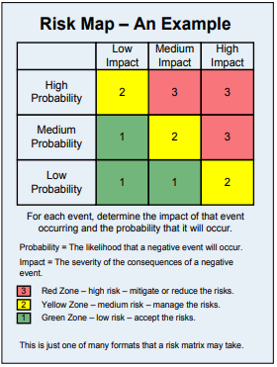
Agency Level: Risk Assessment – Risk (Heat) Map
Notes:
A visual matrix can be used to categorize and measure risk events. A Risk or Heat Map allows you to compare and evaluate risk based on the potential impact and likelihood of an event occurring.
This is one of many formats that may be used to measure risks.
In this format:
The higher the risk impact value, the more severe the consequences, indicating the need to mitigate risks (Red Zone)
The higher the risk probability value, the more likely a negative event will occur.
An agency risk response must be determined. And controls established to mitigate risks.

Slide 22
Agency Level: Control Activities - #3
Definition: The agency’s implemented controls, which are deployed through its policies and procedures to help ensure the risk response are effectively carried out.
Purpose: Establish controls to mitigate risks, and events that prevent achievement of objectives.
Notes:
The 3rd of the 5 Agency-Level components are the Control Activities.
Control Activities are the agency’s controls which are implemented and deployed through its policies and procedures.
These Control Activities help mitigate risks and help ensure the risk responses are effectively carried out.
When control activities adequately mitigate risks, they can help achieve an agency’s goals.

Slide 23
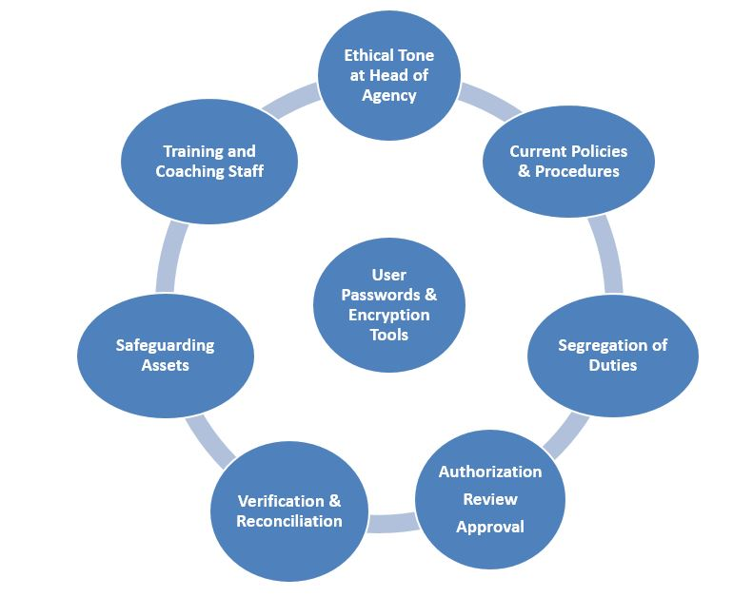
Agency Level: Tips – Control Activities
Preventive
Detective
Corrective
Directive
Mitigating
Compensating
Redundant
Notes:
Controls Activities should exist at every level of the agency, and in all functions.
Controls can be :
Preventive to deter undesirable events;
Detective to detect undesirable events;
Corrective to allow automated or manual correction of errors;
Directive to encourage a desirable outcome;
Mitigating to reduce the potential impact of an event occurring;
Compensating to compensate for the lack of an expected control; and
Redundant which is used when a key control fails; these controls act as a backup control.
The control activities should provide reasonable assurance, for example, that:
Transactions have been reviewed for accuracy by appropriate personnel;
Reconciliations are done to compare source documents to data recorded in accounting systems;
Appropriate review and approval of transactions and reconciliations have been performed;
Computer controls exist to ensure appropriate security, access and encryption controls;
Duties are segregated to reduce the risk of fraud, and only one person completing a fiscal process; and
Training and coaching are provided to reduce the risk of error and inefficiency in operations due to lack of training.
Controls should also be considered in terms of the cost or benefit, efficiency, effectiveness and other pertinent implications to the agency.

Slide 24
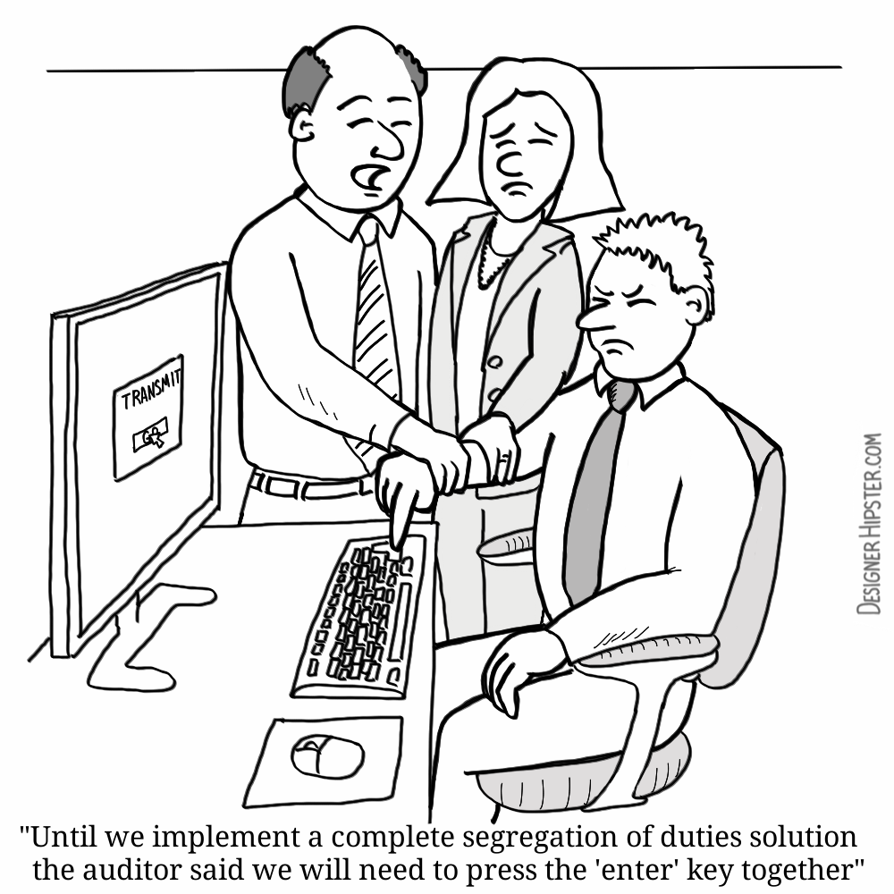
Agency Level: Cost/Benefit/Quality/Reputation Considerations – Control Activities
Designer Hipster Cartoon. Segregation of Duties. Retrieved from DesignerHipster.com. License purchased May 5, 2018.
Notes:
Here is a humorous example of an organization using an inefficient approach to segregation of duties controls: It reads:
“Until we implement a complete segregation of duties solution, the auditor said we will need to press the “enter” key together.”
This is an inefficient control activity and certainly a waste of human resources.
Controls should be considered in terms of their cost or benefit to the agency. However, compliance with laws, regulations, policies and procedures take precedence in these decisions. When it comes to designing and implementing strong internal controls, the cost implications of potential non-compliance with federal and state regulations, or the cost to repair a damaged reputation, often make investing in efficient, effective and preventive controls a significantly better option to mitigate risks.

Slide 25
Agency Level: Information & Communication - #4
Definition: The communication of relevant information in a timeframe to enable staff to carry out their responsibilities. Effective communication occurs down, across, and up the agency.
Purpose: Effective information and communication ensures a clear message of objectives, risks, controls, and other pertinent information to those that need it.
Notes:
The 4th of the 5 Agency-Level components is the Information and Communication area.
The Information and Communication component is necessary to ensure relevant information is communicated in a timeframe which enables people to carry out their responsibilities.
Effective communication sends a clear message and occurs throughout the agency: vertically and horizontally.
The entire agency needs information to handle risks, provide services, and achieve objectives.
Simply put, “Information has no value without communication.”

Slide 26
Agency Level: Tips: Information & Communication
Is Management receptive to employee concerns, suggestions, and complaints
Communication timely and effective across the organization (internal/external)
How does the agency communicate? Do they have meetings? Intranet Communications? Memos? Training? Town Hall Meetings?
Agency standards for business conduct are conveyed to external/third parties and SOC reports obtained
Info. security and does Issues get disseminated to the right level and resolved appropriately
Notes:
These are some examples of areas to determine the existence of controls in the Information and Communication areas:
Is management receptive to employee concerns, suggestions, and complaints?
Is communication timely and effective across the organization?
Is financial reporting Information communicated timely?
How does the agency communicate? Do they have meetings? Use an Intranet? Memos? Town Hall Meetings? Training?
How is the importance and relevance of internal control conveyed, along with the roles which support it?
Are agency standards for business conduct conveyed to third parties? Are third party provider SOC reports obtained.
Is information secure? Does information or Issues get disseminated to the right level of management or staff, and resolved appropriately?

Slide 27
Agency Level: Monitoring - #5
Definition: The process that assesses the presence and quality of internal control performance over time; along with improvements.
Purpose: Evaluate the design and operation of controls on a timely basis and ensures action is taken when specific controls are not functioning.
Notes:
The last of the 5 Agency-Level components is the Monitoring area.
Monitoring is the process of determining the presence, quality and functioning of internal control performance over time.
Regular attention should be given to the design and operation of controls, to ensure action is taken when controls are not functioning as intended.
On-going Monitoring can be built into normal, recurring operating activities or may stem from separate evaluations.
Monitoring also includes follow-up control testing related to Corrective Action.

Slide 28
Agency Level: “Tips: Monitoring”
Monitoring is used to test and evaluate whether the Internal Control Plan is up to date
Monitoring includes the agency conducting independent self–assessments; including the ARMICS Annual assessment
Documentation and audit trail of monitoring activities, an evaluation of the results; reporting any deficiencies, and take corrective actions
Accountability for management, supervisors and staff monitoring controls and providing feedback
Notes:
Effective monitoring can help an agency determine if its Internal Control Plan is up to date, and must include:
The agency conducting independent self–assessments of internal control, including the ARMICS annual assessment;
Maintaining documentation of its monitoring activities, including the results, any deficiencies, and corrective action; and
Management, supervisors and employees are held accountable for monitoring control activities and providing feedback.

Slide 29
Agency Level: Assessment – Every 3 years or sooner*
Agency must repeat the Agency-Level
Assessment at least every 3 years or sooner.*
The Agency should refresh and refine the Agency-
Level control evaluation every year considering:
Any changes to the organization, its management, systems or functions from its prior implementations of ARMICS*
Control issues identified internally from prior ARMICS reviews, DOA Quality Assurance Reviews (QARs), APA audits, or other sources*
Notes:
After successful implementation of the Agency-Level Assessment, the agency must repeat the agency-level process at least every 3 years, if not sooner.
In addition, the agency should refresh and refine the agency-level control evaluation every year, considering:
Any changes to the organization, its management, systems or functions since its prior implementations of ARMICS;
If significant control issues were identified from a prior ARMICS review, DOA Quality Assurance Reviews (QARs), APA audit, or other sources.

Slide 30
Transaction - Level Annual Assessment (Stage 2)
Identify & document each
Significant Fiscal Process*
Perform a Risk Assessment of each Significant Fiscal Process
Identify Controls &
Test the Controls
Each agency must:
DOCUMENT
EVALUATE
TEST
TRANSACTION-LEVEL
CONTROLS
NOTE: Monthly Reconciliations and CAFR Submissions must be included as a Significant Fiscal Process
Notes:
Once the Agency-Level Assessment has been performed, tested, and documented, agency management must complete the Transaction-Level Assessment – Stage 2.
The Transaction-Level assessment requires agencies to identify, document, evaluate, and test the control activities related to the individual fiscal processes that generate transactions in CARDINAL, or in agency-based systems that transfer information to CARDINAL.
Agencies should:
Identify and list all of the significant fiscal processes which affect CARDINAL or the financial statement directive submissions;
Include Monthly Reconciliations and Financial Reporting in the CAFR as significant fiscal processes;
Conduct a risk assessment of each significant fiscal process identified; and,
Design control activities to prevent or detect potential risk events. Then, agencies must test the effectiveness of those control activities and document the results.

Slide 31
Transaction Level: “Tips on Annual Testing (Stage 2)”
Agency should monitor, update and retest the Transaction-Level controls annually
Determine if any organizational OR functional changes require a re-evaluation of the fiscal processes determined to be significant
For significant fiscal processes that have not changed since the prior year, retest the key controls to ensure that they are still working
Processes that were improved as the result of CAP, should be tested to ensure the new or enhanced controls have addressed the internal control weakness
Notes:
The agency should update and retest the Transaction-Level controls annually, by completing the following:
Determine if any organizational OR functional changes occurred which may require a re-evaluation of those processes that were previously determined to be significant for the agency.
Retest the key controls for all significant fiscal processes that have not changed since the prior year to ensure that they are still working.
Test processes that were improved as the result of completing corrective action to ensure the new or enhanced controls have adequately addressed the internal control weakness in the prior year’s corrective action plan.

Slide 32
ARMICS Documentation
Formal documentation of the ARMICS assessment process, tests performed, AND results of the assessment MUST be maintained at the agency, and made available for review by the Department of Accounts and other appropriate parties.
(Electronic Files or Hard-Copy documentation is acceptable)
Notes:
Formal documentation of the annual ARMICS assessment process, tests performed, AND results of the assessment MUST be maintained at the agency, and made available for review by the Department of Accounts and other appropriate parties.

Slide 33
ARMICS Certification
ARMICS annual certification must be submitted to the Department of Accounts by September 30th of each year based on the agency’s June 30 status of ARMICS compliance
Agencies may not certify compliance unless they have performed ARMICS in accordance with standards
Certification Statements are included as exhibits in CAPP Topic 10305
Notes:
Each agency must certify annually on the status of Internal Control. The certification status is as of June 30th however, agencies have until September 30 (or the last business day, prior to September 30, if the due date falls on a weekend).
Agencies cannot certify compliance unless they have conducted the annual ARMICS assessment in accordance with the Standards and met the minimum requirements.
DOA provides Certification Statement exhibits in CAPP Topic 10305 that agencies may use to communicate the results of annual ARMICS assessments.

Slide 34
ARMICS Information
Located on the DOA website
ARMICS Standards:
Agency Risk Management and Internal Control Standards
CAPP Manual Topic 10305 (Internal Control):
CAPP_Topics_Cardinal/10305.pdf
Notes:
The ARMICS standards and CAPP Topic 10305, Internal Control, are all located on DOA’s website under the “Reference” tab.

Slide 35
ARMICS ONLINE TOOLS
Located on DOA’s Website
ARMICS Review Checklist (Checklist of areas to consider while performing the Annual ARMICS assessment)
ARMICS Questionnaires (Surveys to gain insight and feedback from agency staff)
ARMICS FAQS (Quick answers to typical agency questions)
Notes:
There are online tools available on DOA’s website that assist with the ARMICS process; however, the use of these tools is not required:
The ARMICS Review Checklist is a checklist of areas to consider while performing the annual ARMICS assessment
The ARMICS Questionnaires are Surveys to gain insight and feedback from agency staff
The ARMICS FAQs are quick answers to typical agency questions
Keep in mind, these online tools do not substitute for the agency’s independent verification of the existence of controls, nor do they replace required testing, to determine if a control is functioning adequately.

Slide 36
ACFE: 2018 “Report to the Nations”
2018 Report to the Nations. Copyright 2018 by the Association of Certified Fraud Examiners, Inc.
Notes:
As we conclude this training, a few statistics are provided on the need for Internal Control:
In the Association of Certified Fraud Examiners “2018 Report to the Nations,” the Association studied over 2,000 cases of occupational fraud in 125 countries, and 23 different industries.
The results of the study show that internal control weaknesses were responsible for nearly half of all frauds.

Slide 37
ACFE – Government Median Losses
2018 Report to the Nations. Copyright 2018 by the Association of Certified Fraud Examiners, Inc.
Notes:
The 2018 Report to the Nations indicated that the greatest number of fraud cases in the study occurred in the banking and financial services, manufacturing, and government and public administration sectors.
The government and public administration industry represented 201 of the cases studied, with losses related to fraud averaging $125,000.
These statistics convey the need for internal control and the importance of internal control in our organizations.

Slide 38
What Role will Your Agency Play?
Best Managed State in the Nation
Notes:
What role will your agency play in achieving it’s objectives?
What role will your agency take in Virginia achieving it’s long-term objective of being the Best-Managed State?

Slide 39
References
ACFE - Report to the Nations. (2018). 2018 Global Study on Occupational Fraud and Abuse. Copyright 2018 by the Association of Certified Fraud Examiners, Inc.
Agency Risk Management and Internal Control Standards. (2015). Commonwealth of Virginia, Department of Accounts. Pg. 5 - 13
Comptroller General of the United States (2014). Standards for Internal Control in the Federal Government. United States Government Accountability Office.
COSO. Committee of Sponsoring Organizations (COSO) of the Treadway Commission. “How the COSO Frameworks Can Help.” (2014). https://www.coso.org/Documents/2014-2-10-COSO-Thought-Paper.pdf
Designer Hipster Cartoon. Segregation of Duties. Retrieved from DesignerHipster.com. License for use purchased May 5, 2018
Virginia Department of Accounts. Office of the Comptroller. (2015). Agency Risk Management and Internal Control Standards. Pg. 5.
Virginia General Assembly, Joint Legislative Audit and Review Commission (JLARC). (2017). "Virginia Compared to Other States" "Bond Ratings" (22).
Virginia Performs. Bond Rating. (2017). "Bond Ratings." What is the State’s Role?
Notes:
This is a list of several sources for information pertaining to internal control.

Slide 40
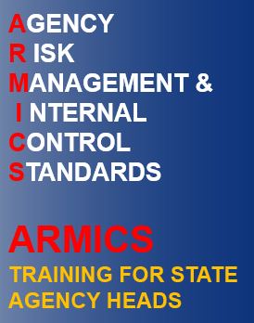
Completion
Notes:
You have completed the ARMICS Training for State Agency Heads.
Please exit this module by clicking the Exit button at the top of this window.

